Slide 1


INTERNET BANKING
By :
BATCH – 98
CHETHAN N (EMP ID : 6624)
AVINASH TILAVALLI (EMP ID: 6622)
PUNIT MISHRA (EMP ID : 6609)
VIJAY KUMAR (EMP ID : 6614)

Slide 2

Introduction
Problem Statement
System design
Technology
Results
CONTENTS

Slide 3

Internet banking or online banking or net-banking is a digital payment system which enables customers of a bank or a financial institution to make financial or non-financial transactions online via the internet. This is online banking system in Java. In this program, we will add some basic functionalities of a bank account like a deposit of amount, withdrawal of amount, Fund transfer, Bank statement.
INTRODUCTION

Slide 4

Customer information centers in banks are unable to serve such queries at peak periods. For every information regarding your bank account you need to visit different counters Every different counters have there separate queues which is time consuming
PROBLEM STATEMENT

Slide 5
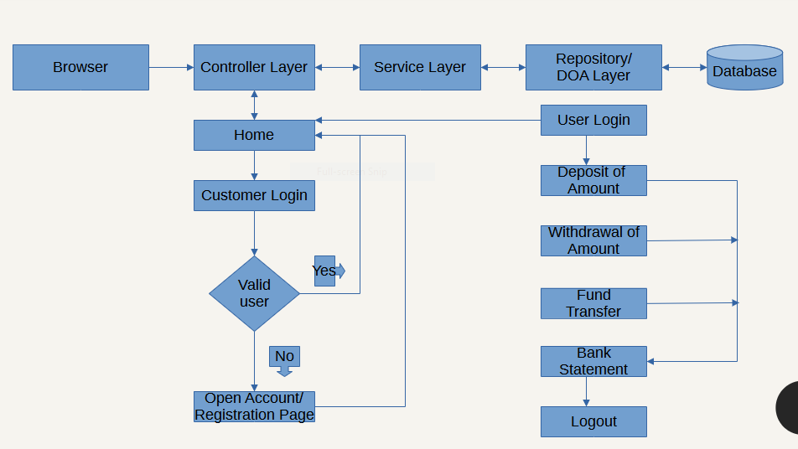
SYSTEM DESIGN

Slide 6

Spring boot MVC
HTML5
CSS3
MYSQL
TECHNOLOGIES

Slide 7
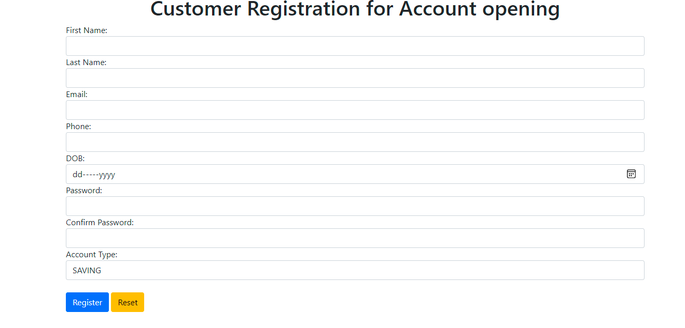
REGISTRATION PAGE

Slide 8
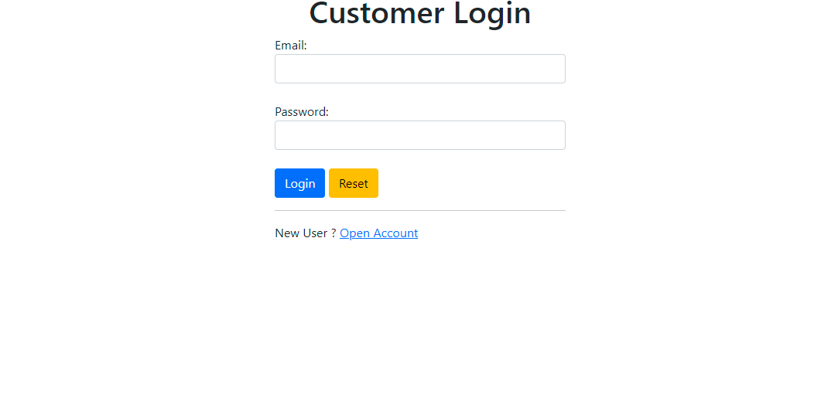
LOGIN PAGE

Slide 9
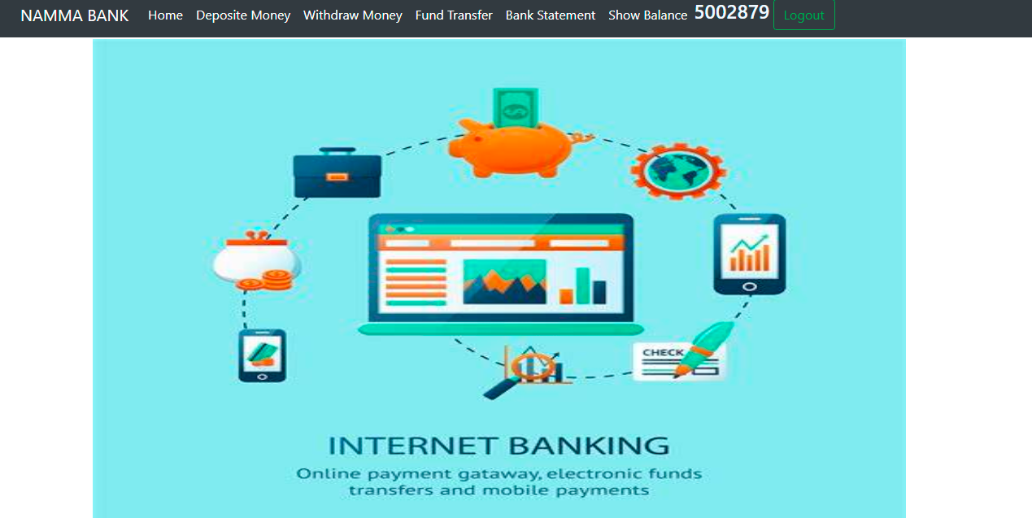
HOME PAGE

Slide 10
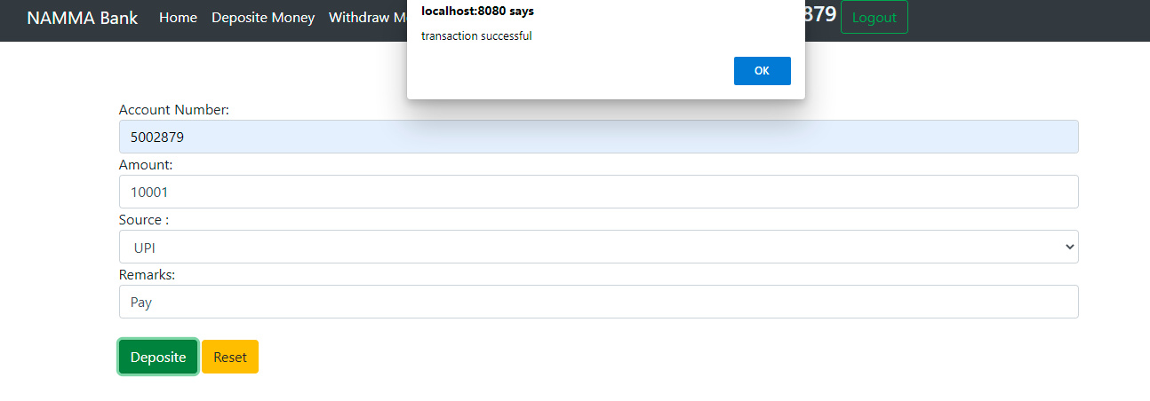
DEPOSITE MONEY

Slide 11
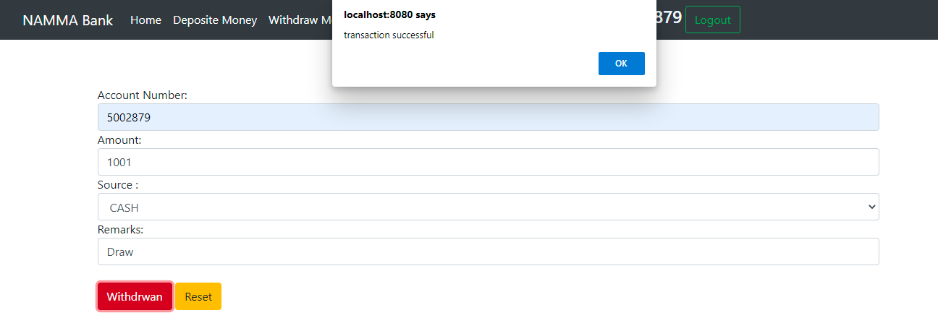
WITHDRAW MONEY

Slide 12
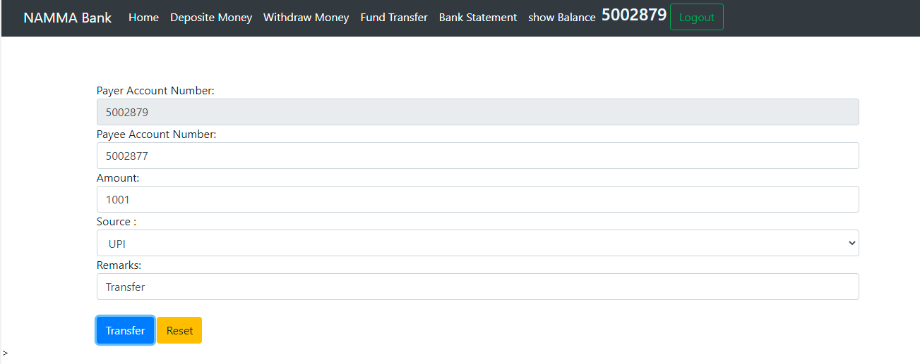
FUND TRANSFER

Slide 13
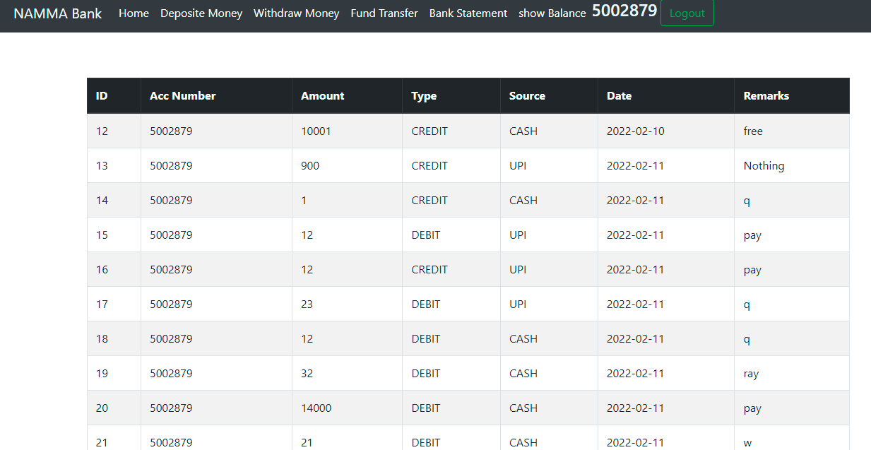
BANK STATEMENT

Slide 14
THANK YOU

